Slide 1

maetS
Group JJNW
Presented by Nick and Will

Slide 2

Recap
maetS
A web application to buy, sell and bid on games, merchandise, expansion packs, and user created content.
Sellers will be able to set the price of the content and potential put items up for free.

Slide 3

Added Functions
Shop
User viewable shop displaying content for sale.
Wish list
Users will be able to save and rank items for later purchase.

Slide 4
Wish List Use Case
You find a copy of the Pokémon Master Trainer board game
The price is set to 200 dollars but you don’t currently have the funds
You put it on your wish list so you can easily go back and find it later
When the item is bought before you have a chance to buy, you is notified via email and it is removed from your list

Slide 5
Personal Shop Use Case
You decide that you have a lot of tabletop games you will no longer be playing and would like to sell for some extra cash to support your habit
You go to your profile and open a shop and put in all of your extra games
You can now distribute this link to buyers and display all of your items in one unified location
Users who find an item in this shop while using the search feature can also click a link and view the rest of the items in your shop.

Slide 6
Sale Item Use Case
You just bought Minecraft and want to get some mods
Browse to Minecraft->Mods
Find the mod you want and click “buy”
Check email for your download link

Slide 7
Auction Item Use Case
You want a plush of Rammus
Search for “Rammus plush” in the search bar
Click on an auction listing and enter a bid
Some time later, you are notified by email that you were outbid
Go to your bid history and place a higher bid
Win the Rammus plush and then make the payment and receive it in the mail

Slide 8
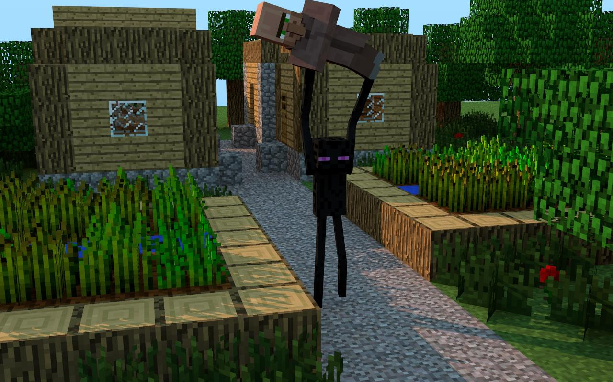
Technical Survey
Front end:
HTML5/CSS
JavaScript
Back end:
MySQL
Java

Slide 9
HTML5/CSS/JavaScript
HTML5/CSS
Bootstrap
JavaScript
Jquery
RequireJS
AngularJS

Slide 10
MySQL
PHPMyAdmin
User Interface
MySQL

Slide 11
Java Web Server
JSP(JavaServer Page)
Java embedded in HTML
Templating dynamic web pages
Database interaction
JDBC(Java Database Connectivity)

Slide 12

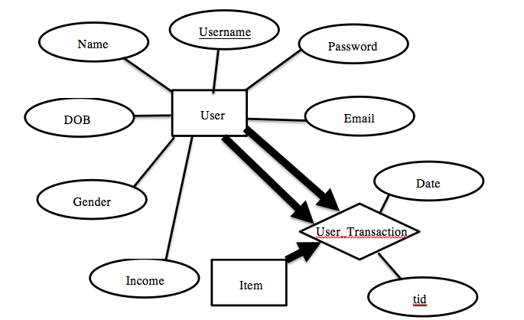
Entity-Relation Diagrams
User Entity and User_Transaction Relationship

Slide 13
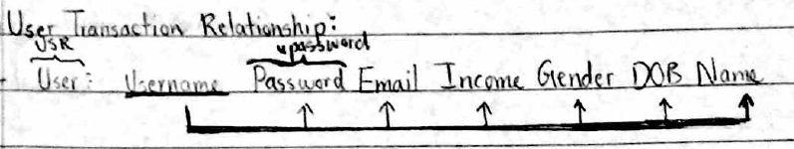
Schema

Slide 14
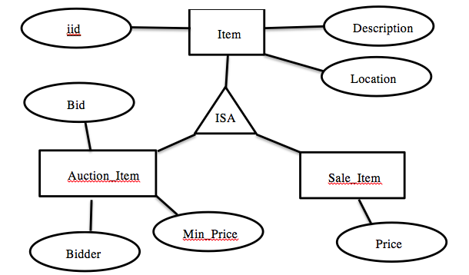
Entity-Relation Diagrams
Item Entity-Relations

Slide 15
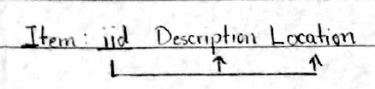
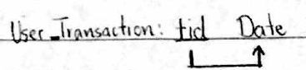
Schema

Slide 16
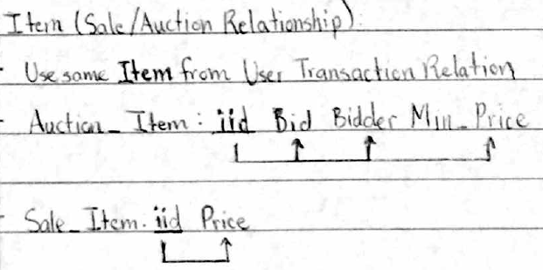
Schema

Slide 17
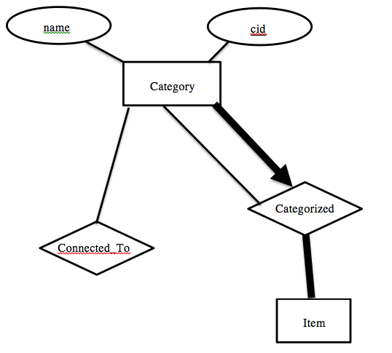
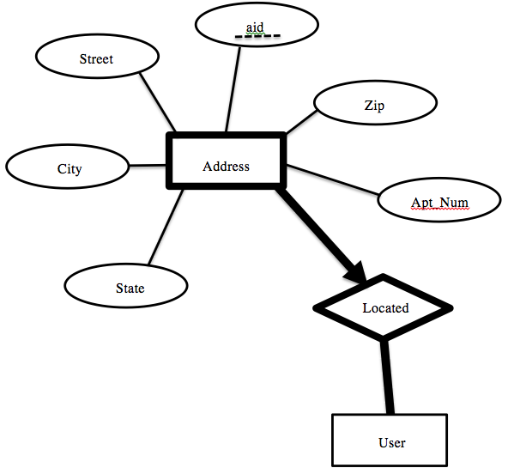
Entity-Relation Diagrams
Category Entity Relationship
Address Entity Relationship

Slide 18
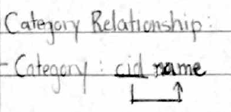
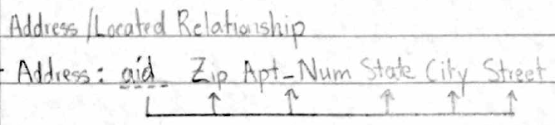
Schema

Slide 19
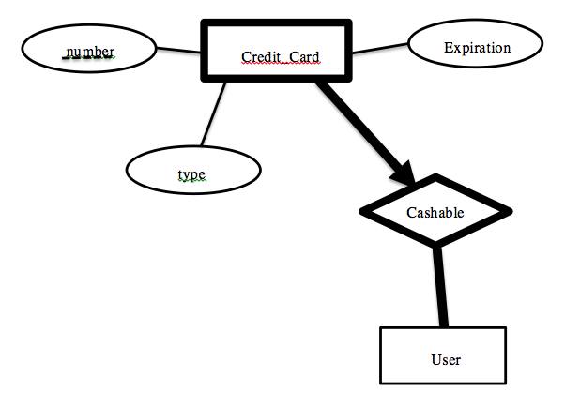
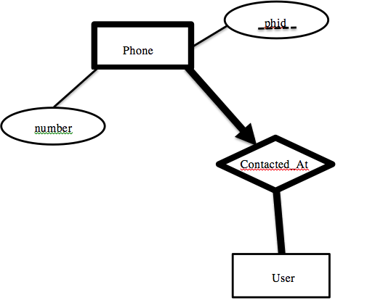
Entity-Relation Diagrams
Phone Entity-Relationship
Credit Card
Entity-Relationship

Slide 20
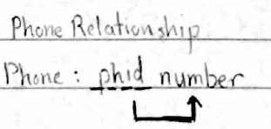
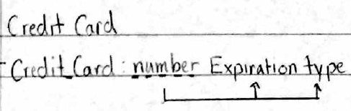
Schema

Slide 21
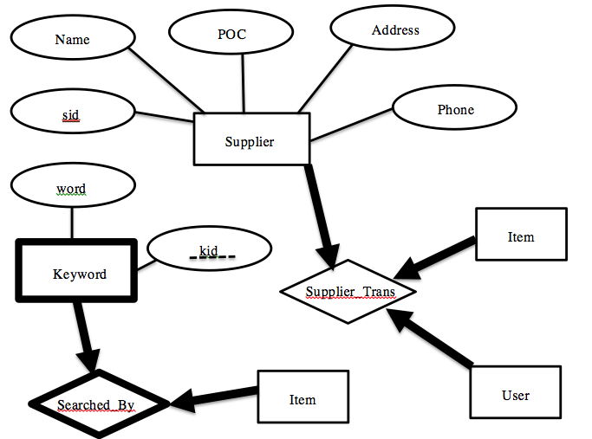
Entity-Relation Diagrams
Supplier Entity-Relationship

Slide 22
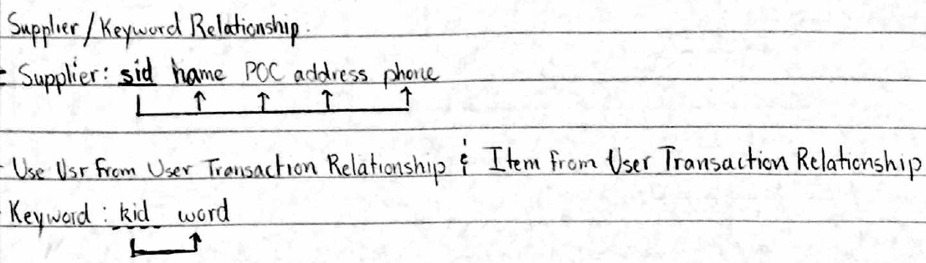
Schema

Slide 23
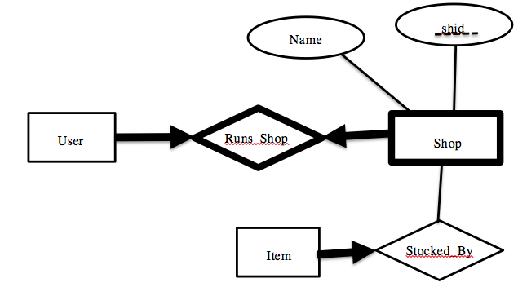
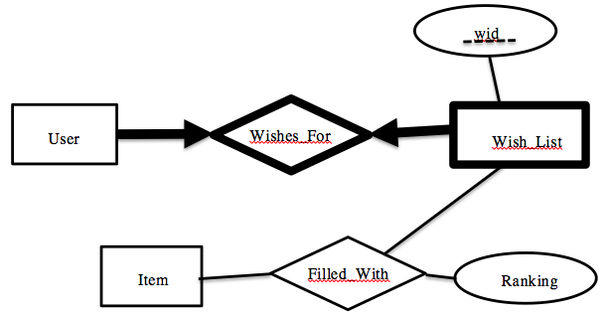
Entity-Relation Diagrams
Shop Entity-Relations
Wish list
Entity-Relations

Slide 24
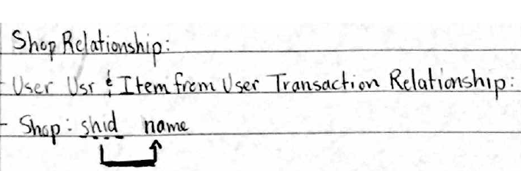
Schema

Slide 25
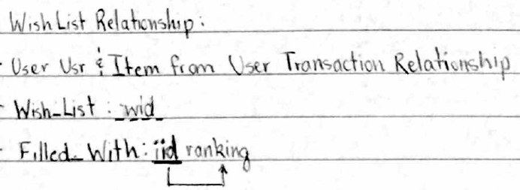
Schema

Slide 26
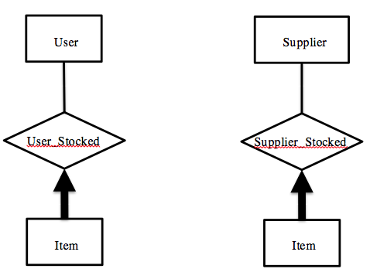
Entity-Relation Diagrams
User Stocked
Entity-Relationship
Supplier stocked
Entity-Relationship

Slide 27
Entity-Relation Diagrams

